Slide 1
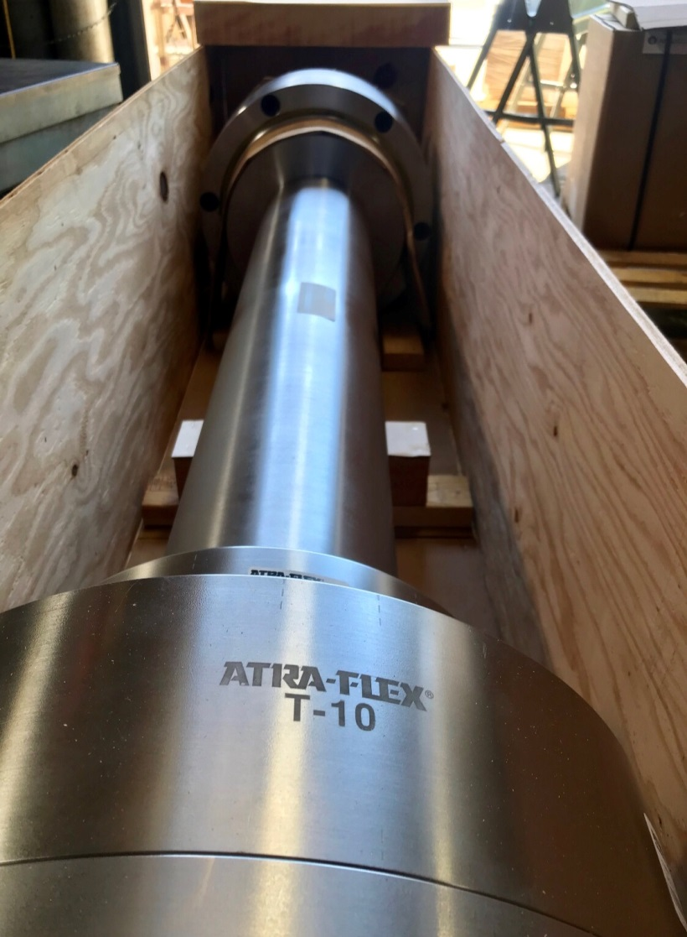
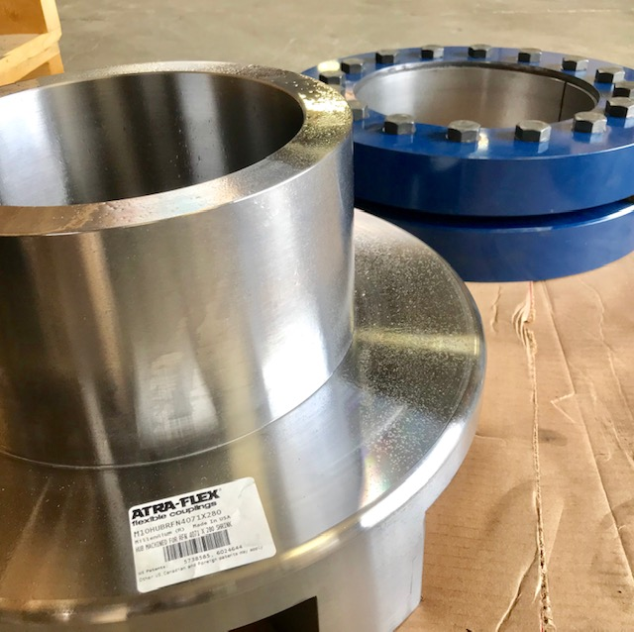
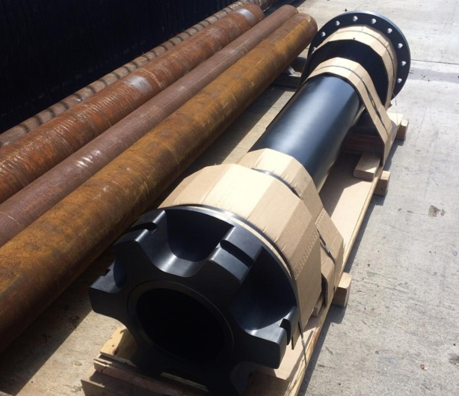
Large Enough to Handle Your Toughest Applications, Small Enough to Care.

Slide 2
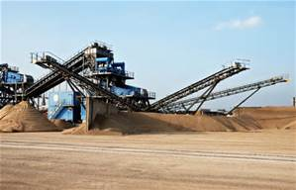
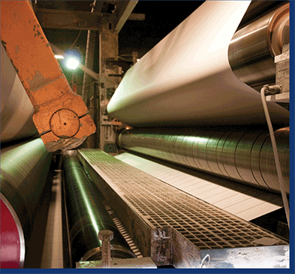
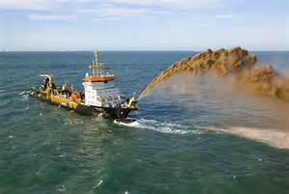
Providing Coupling Solutions and Exceptional Customer Service Since 1980
Industries We Serve:
Pulp and Paper
Forestry
Steel Mills
Dredging
Food and Processing
Oil and Gas
Mining
Phosphate Mines
Cement / Aggregate
Marine
Chemical
Pump Systems
Agriculture
Power Generation

Slide 3
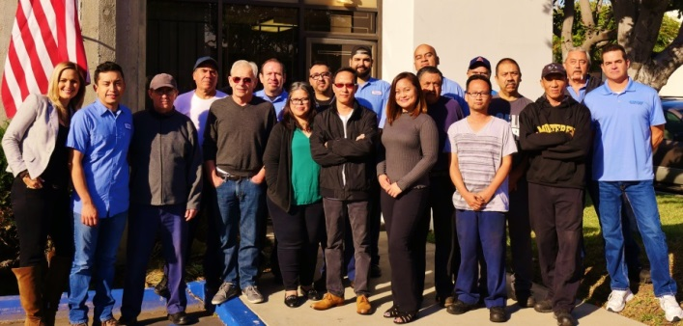
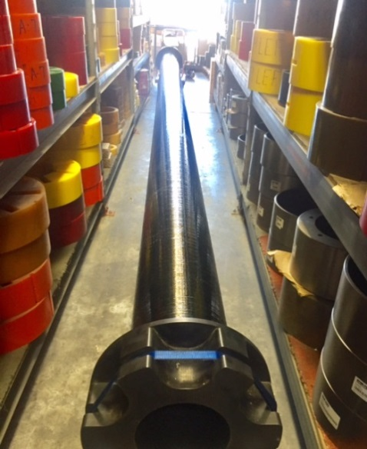
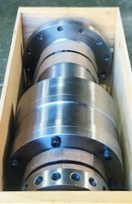
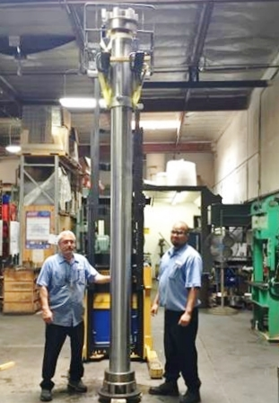
Recognized for unparalleled technical support and delivery times, we continue to strive and meet our customers needs.
We are an independently owned coupling manufacturer and continue to stand behind our product while always striving to meet and remain extremely reactive to our customers needs. Receive quick quotes with great customer service, rush orders or last minute technical support.

Slide 4
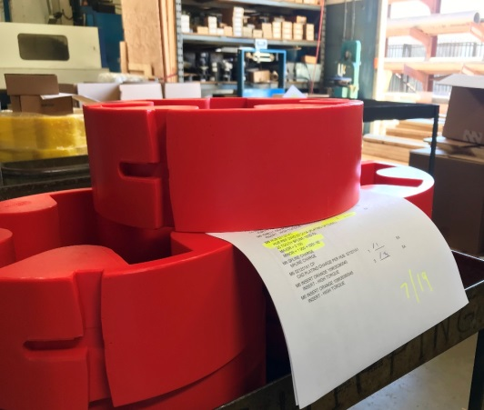
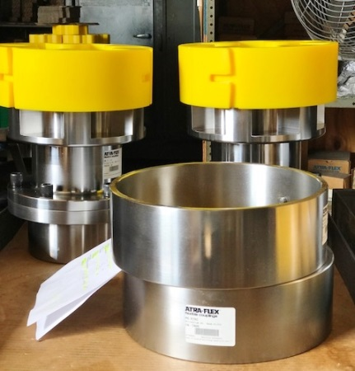
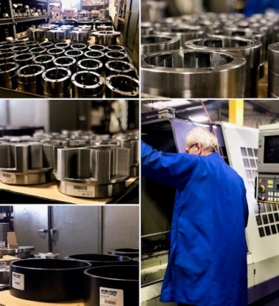
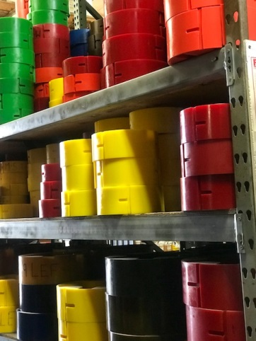
Why We Stand Out from the Competition? Your Urgency or Emergency Becomes our Priority
We understand and are comfortable with the mission critical and time sensitive nature of projects that we undertake. Our mission is to offer steadfast support to our distributors and their customers no matter what time of the day or night. Our goal is to exceed your expectations and create the relationship and dependability you and your customers want and trust.
Night shift on hand 4 days per week.

Slide 5
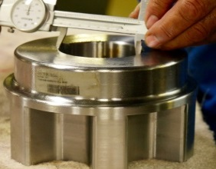
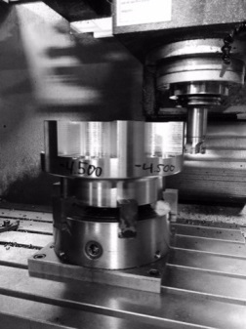
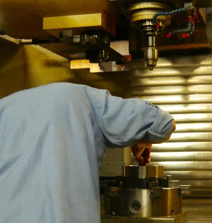
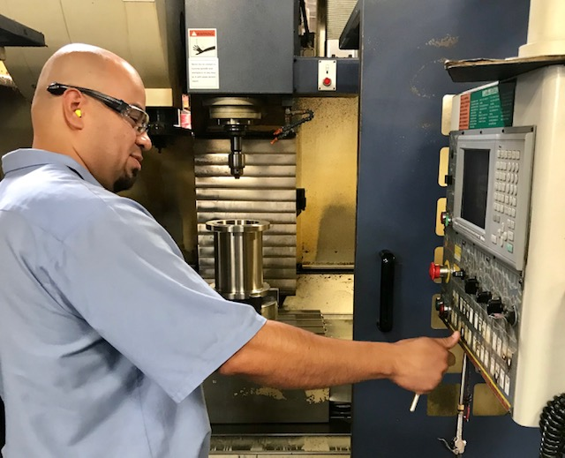
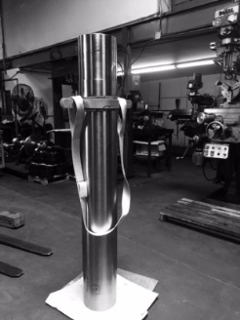
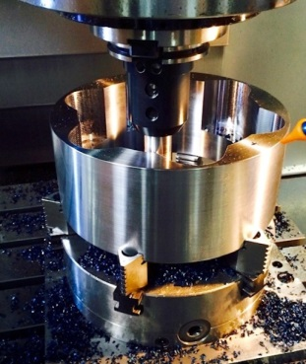
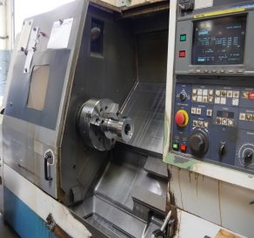
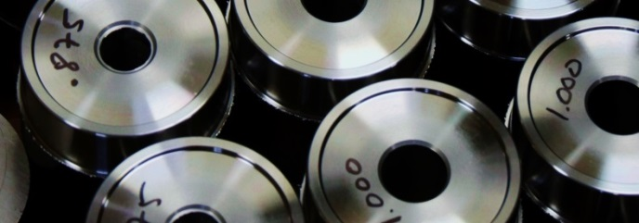
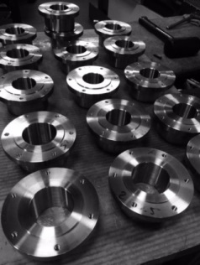
Quality manufacturing you can rely on…. shipped out on schedule. We deliver on our promises.
ATRA-FLEX® Couplings are proudly manufactured in the USA.
*Standard hubs are machined from solid carbon steel rounds and tubing, maintaining tight tolerances which provides excellent coupling balance. Precision machined hubs.
*Stainless steels in grades 303,304 and 316 are also available for corrosive environments and food applications. applications.
*Corrosion Resistant Melonite Process offering cost savings alternative to Stainless Steel.

Slide 6
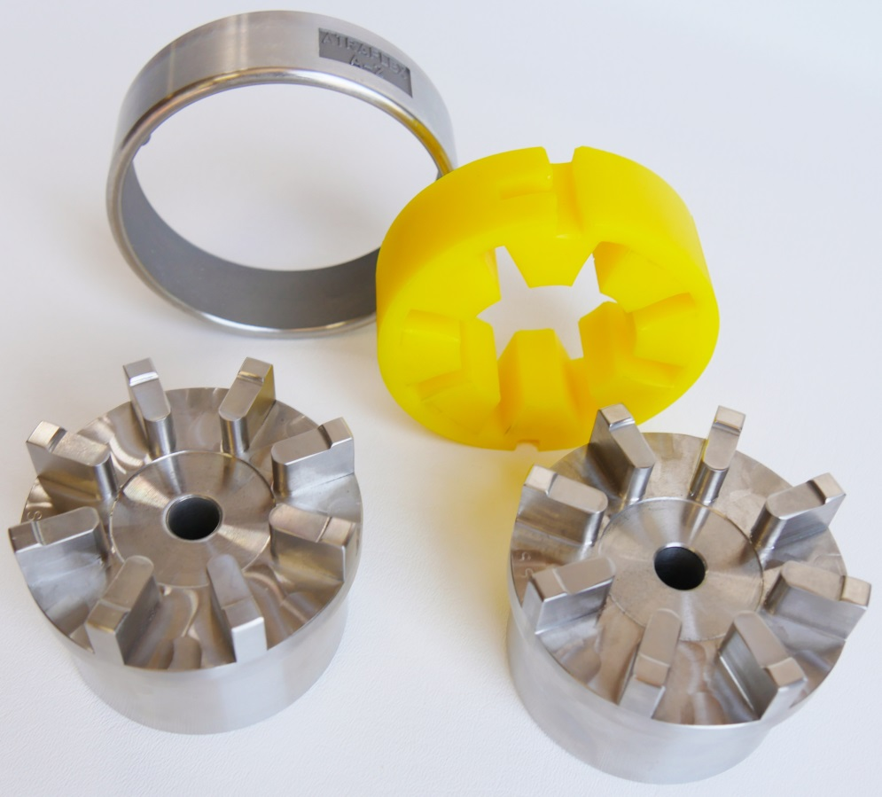
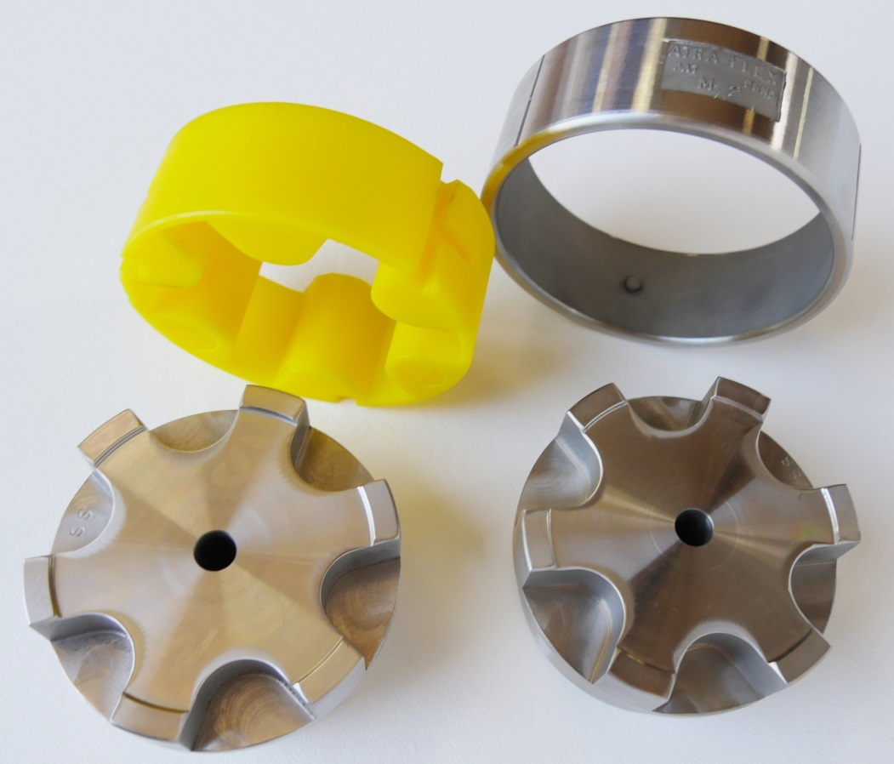
ATRA-FLEX® remains innovative as we continue to provide superior coupling solutions.
Millennium Series® More internal support of insert allows for higher torque rating in a smaller package.
Original 1980 A Series®
Multiple knock offs in the market since A Series patent expired

Slide 7
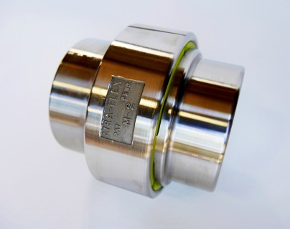
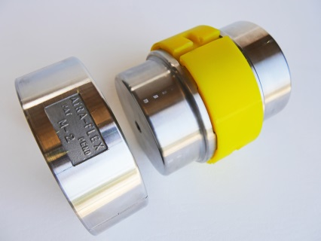
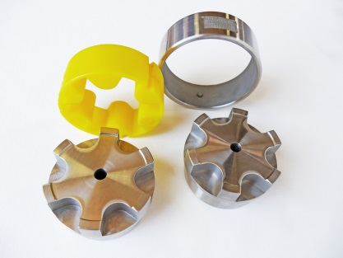
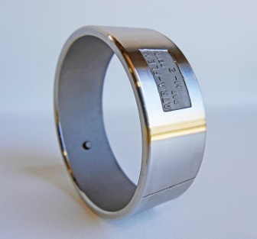
ATRA-FLEX Millennium®
Improved Design from Original A Series- Higher Horse Power in a Smaller Package
Detect and lock-on ring feature
No nuts or bolts; easy install.
No need to move equipment when replacing insert
No metal to metal parts; no need to replace hubs
No lubrication needed
“Internal Support” of Insert for higher HP
Higher horse power in a smaller package vs other elastomeric designs
Large bore capacity, up to 16 inch shafts
No exposed shaft on spacer coupling
Very economical ; save on maintenance downtime expenses
Torque ratings up to 3,610,000 LB-IN, much more than similar knockoff styles
Accommodates parallel, axial and angular and misalignment

Slide 8
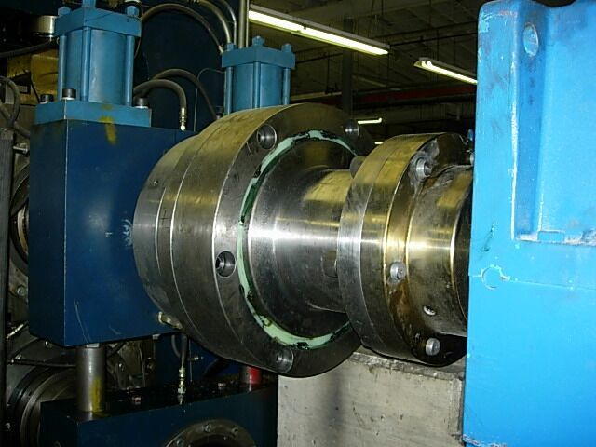
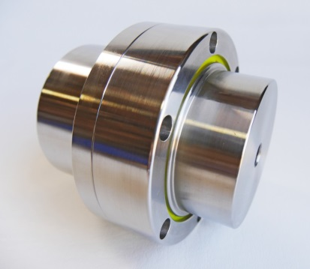
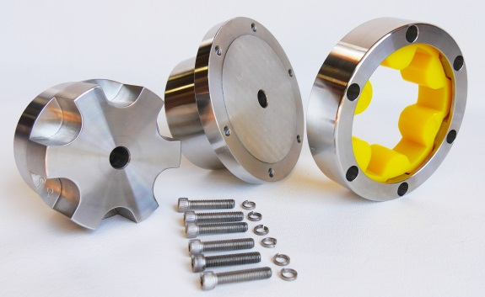
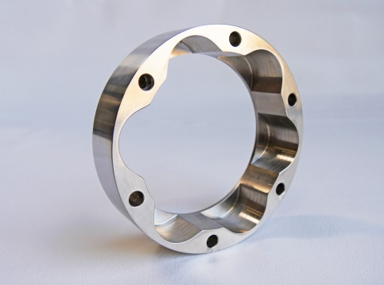
ATRA-FLEX T-FLEX Patent # 7,244,186
Heavy duty, high performance couplings driven on a horizontal Plane . Bolt on ring
Features Patented T-Flex® absorbs extreme torsional shock and vibration
while accommodating angular, parallel, and axial misalignment without generating reactionary loads, which significantly increases bearing life.
Application Range T-Flex® coupling sizes available to transmit torque loads from 60 lb-in to over 1,570,000 lb-in with shaft capacities ranging from .375 to over 20.00 running from low rpm to over 18,000 rpm.
T-Flex® uniquely combines the stability of a compression type coupling with the safety of a shear coupling. In the event of a lockup, the insert will shear, minimizing the possibility of damaging your rotational equipment. No lubrication or routine maintenance is required

Slide 9
WHY Choose ATRA-FLEX®
We are committed to offering a superior coupling option and providing solutions
Outperforms the competition: USA MADE couplings insure quality manufactured couplings that create more efficiency and reliability
Accepts misalignment up to 2 degrees.
Excellent choice for standardization: Replace or retrofit all styles of couplings in high and low torque applications.
Reduce Inventory: No metal to metal contact allow you to lower your inventory of spare parts to inserts only.
Standard inserts have a temperature range from -60℉ to 250℉ with high temperature inserts available up to 350 °F.
A variety of inserts are available in a range of hardness to meet most torsional stiffness and torque requirements and offers very high resistance to chemicals and weather.
Absorbs and dampens torsional vibration shock extending the life of your driven equipment.
Lower total cost of ownership: Save money and downtime with the ease of replacement of inserts. No need to remove hubs or disassemble the driving or driven equipment.

Slide 10
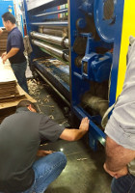
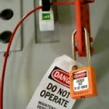
Unscheduled Downtime
What are the biggest challenges of unscheduled downtime ?
Production Loss / Loss of Revenue
Only Focused on Emergency
Labor Costs
Planning for Lockout
Backorders and Delayed Delivery
Often Times Temporary Band-Aid, No Solution

Slide 11
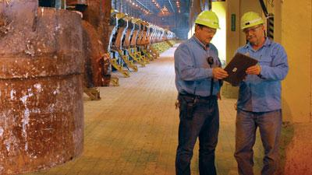
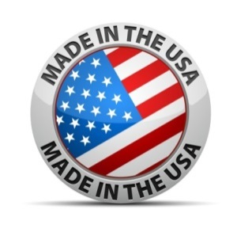
Increase UPTIME and lower downtime expenses with ATRA-FLEX®
Reliability is of top importance in most operations today . Your customers will save money and downtime expenses by using ATRA-FLEX Flexible Couplings. The ease of installation and the ability to change out your polyurethane insert within minutes will often take less time than a lock out/ Tag out procedure. Because ATRA-FLEX is manufactured here in the U.S. means you and your customers will not have to deal with import delivery delays which can cost the plant hundreds of thousands of dollars in extended downtime.

Slide 12
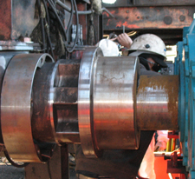
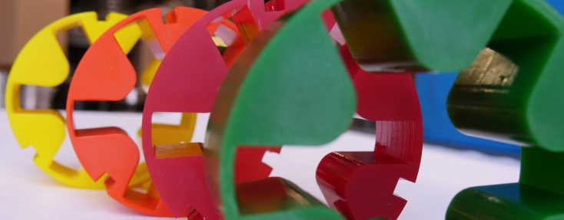
WHY choose an ATRA-FLEX Elastomeric style coupling Vs. Grid and Gear Couplings
Many end users are using grid couplings as a shear device. When these steel grids shear, it can cause serious damage to the hub teeth, many times making it necessary to change the entire coupling. When our urethane inserts shear, there is no metal to metal contact and no need to move your equipment. You simply remove outer ring and quickly replace new insert.
ATRA-FLEX couplings are manufactured in the USA , many grid and gear couplings are not. Our delivery times exceed the competition. All ATRA-FLEX Hubs are 100 percent machined from solid bar and tubing, making them more intrinsically balanced which provides smoother running equipment, less vibration, extended hub life which will extend the life of your equipment saving on overall operation expenses.

Slide 13
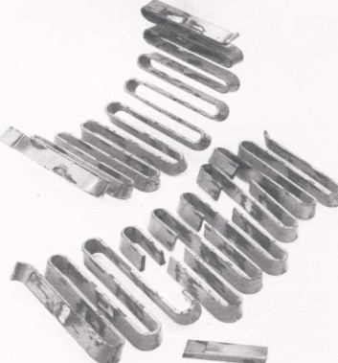
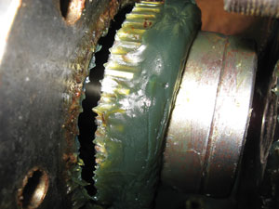
Costs Associated with Grid and Gear Coupling Failures
Lack of procedures =Failures =Downtime=Loss of revenue
Procedures and lack of timely execution
Great lubrication programs are only as good as the people who do the work. Current challenges in finding and keeping long term maintenance crews continues to increase.
As knowledgeable baby boomers retire the steep learning curve in younger generations has been a growing concern for some plants, the lube-tech position may have been held by a single person for decades.
Back orders on replacement coupling parts
Long wait time from China

Slide 14
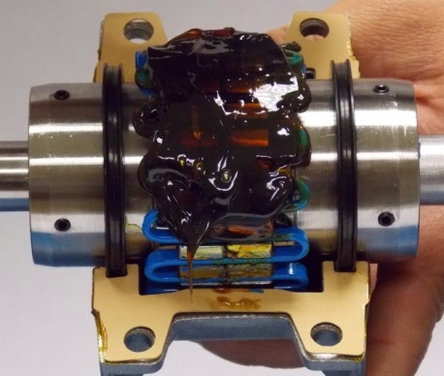
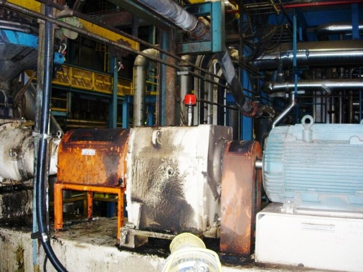
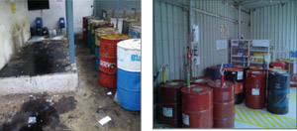
Additional Challenges Associated with Grid and Gear Coupling Maintenance
Couplings Will Need to Be Inspected & Re-Greased Periodically - As a best practice, metallic gear and grid couplings should be inspected regularly and repacked with grease each time. For a new coupling or application, you will want to inspect more regularly to ensure the coupling is behaving properly (i.e. - not leaking much grease). Overtime, application-specific, inspections can be spread out a bit more.
Be Prepared for Possible Leakage of Grease - While gear and grid couplings are renowned for their power density (can carry high torques in a small footprint) and ability to handle axial float (in the case of grid and floating shaft gear couplings), no matter the manufacturer, greased couplings are naturally prone to possible grease leakage. Appropriate care must be taken to minimize environmental concerns, and ensure all relevant environmental regulations that may apply are adhered to.
Storage Rooms / Inventory Space

Slide 15
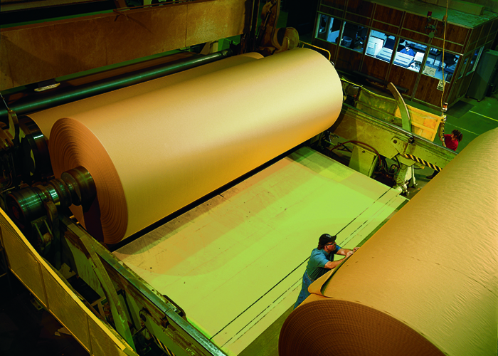
Vernon Brackett, V.E. Brackett Co. Fayetteville, GA Independent Sales Representative for Atra-Flex couplings for over 20 years .
Long term ATRA-FLEX® customer at Large Linerboard plant in Valdosta, GA Standardizes on ATRA-FLEX with corrosion resistant Melonite Process
Large Linerboard Plant, Long time end user of ATRA-FLEX® Flexible Couplings for over 12 years.
Customer continues to save on timely and costly grid and gear maintenance and downtime expenses.
100’s of Grid and Gear Replacements at this plant with added benefits of corrosion resistant MeloniteTM Process.

Slide 16
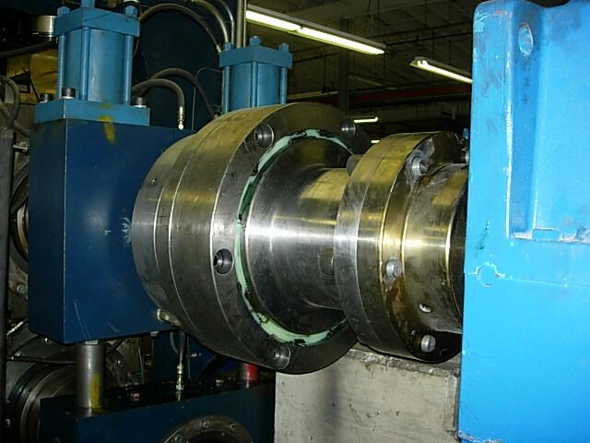
Successful Grid and Gear Replacement Reference
Vernon Brackett, V.E. Brackett Co. Fayetteville, GA Independent Sales Representative for Atra-Flex couplings for over 20 years.
I can tell you that 90% of the applications that we converted to ATRA-FLEX M-Series at this large linerboard plant were Falk gear couplings. At this plant they were fed up with the maintenance involved with maintaining the HUNDREDS of Falk gear (and grid) couplings that were in place back in 2005. They would have a couple maintenance guys spending all day during their planned outages disassembling, cleaning and re-lubricating each gear coupling. By upgrading to our M-Series, they could now inspect our inserts in a matter of just minutes per application. If insert replacement was necessary, it would take just a fraction of the time it would have taken if the Falk gear coupling was still being used. Our M-Series would also allow a weak link in the system that was previously missing. A Falk gear coupling will often provide MANY times the amount of torque transmission than necessary in any given application. In the event of an equipment lock up, the gear coupling will not be the weakest link…leaving much more expensive pieces of equipment vulnerable to damage or destruction. Because of this, it is very important not to replace a Falk gear coupling simply by a part number cross-reference. It is important to gather all of the application specific data, such as input HP, shaft sizes, output torque requirement (if available), duty cycle, ambient temp…etc….so as to make sure the right Atra-Flex coupling is sized for your application.

Slide 17
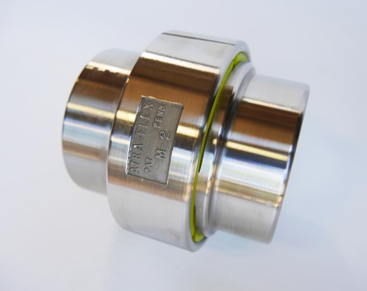
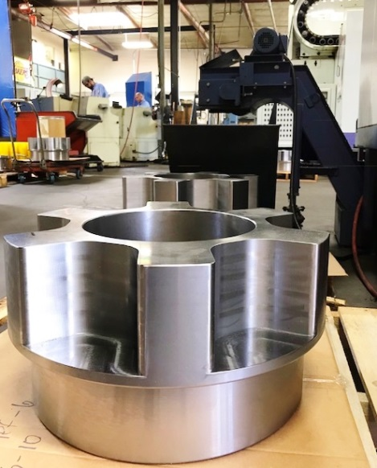
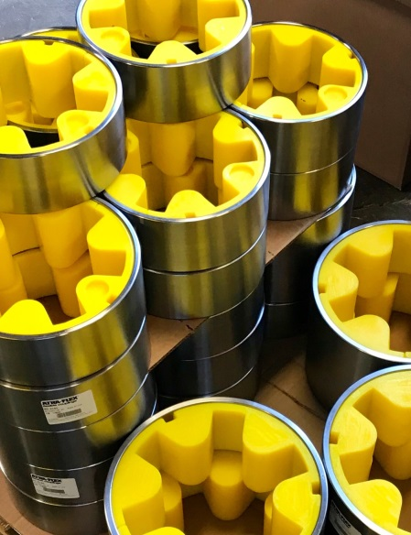
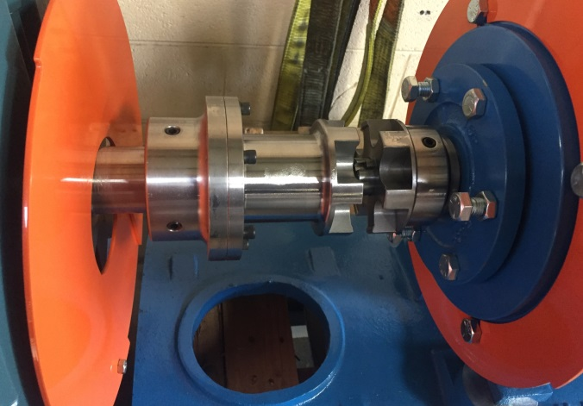
Millennium® “M” Series Demo
New and improved design can handle larger applications than other elastomeric styles
Curved teeth create more internal support of insert almost doubling your torque ratings from the A Series.
Up to 16 inch shafts and can transmit up to 3,610,000 (in-lb) of torque
Original A Series
Millennial Series “M”
Replace in place coupling. No lubrication, no nuts or bolts, easy install and minutes to replace wrap style insert without having to move driver or driven equipment.
Replace Messy Grid and Gear Couplings

Slide 18
Where most elastomeric couplings fall short, ATRA-FLEX continues to handle your most demanding applications. Custom Designs and drawings is a niche we have been respected for in the industry for over 39 years.

Slide 19
Standard Inventory Readily Available
All ATRA-FLEX couplings are manufactured in Santa Ana, CA – standard Inventory ready to hip same day
Additional A and M series Inventory supplied in Fayetteville, GA for rush East Coast Orders.

Slide 20
Over time equipment may change. Multiple Insert options depending application and environment provides your customers the ability to make changes and potentially maintain their existing steel hubs saving customers on timely coupling change outs.
Inserts are high quality polyurethane which is extremely resistant to most chemicals.
Our Standard yellow insert accommodates most applications. Always follow quick selection guides and follow torque ratings. Do not “bump” up into a higher torque insert unless specified by an ATRA-FLEX Specialist.

Slide 21
ATRA-FLEX® MeloniteTM Process Option Provides Customers with a Significant Cost Savings Alternative to Stainless Steel
Increased surface hardness of carbon steel up to 57.6 RC will extend life of hubs
Enhanced corrosion resistance for wet or damp environments
Great alternative for harsh chemical and wash-down areas
Lower coefficient of friction and added lubricity extends life of insert

Slide 22
Labor cost that come with lengthy and troublesome Installations and repairs
ATRA-FLEX Flexible couplings have replaced many Grid and Gear couplings saving customers downtime expenses

Slide 23
Easily REDUCE the amount of grid coupling MAINTENANCE by eliminating grease points and lengthy repairs. Leave existing flange hubs and add an ATRA-FLEX drop out spacer coupling to increase UPTIME.
**Page 7 in catalog

Slide 24
Where most elastomeric couplings fall short, ATRA-FLEX is capable of replacing your larger grid, gear and disc pack couplings.
One of the easiest couplings on the market to install & maintain. No lubrication needed. Replacement inserts take minutes to install vs. hours saving your customers on timely coupling repairs.
More dampening with less reactionary loads will ensure longer equipment and bearing life
Transmit up to 3,610,00 (in-lb) of torque and accommodate up to 20 inch shafts
Success on VFD Applications
Once inserts shears there is no metal to metal contact; no need to replace hubs
Easy to standardize on; only replacement inserts to inventory

Slide 25
T- FLEX® Demo
Application Range T-Flex® coupling sizes available to transmit torque loads from 60 lb-in to over 1,570,000 lb-in with shaft capacities ranging from .375 to over 20.00 running from low rpm to over 18,000 rpm.

Slide 26
With our wide variety of coupling styles and custom designs customers have relied and chosen to standardize on ATRA-FLEX®
Brake Wheel
Flywheel
Drop Out Spacers
Floater bolt Coupling
Floater bolt/snap ring couplings
Custom designs
Non spacer
Spacer Couplings
Limited End Float Couplings
Brake Disc
QD Bushings, external and internal taper lock bushings, split taper bushings, Ringfeder and B-Lock locking devices
Axial Slide Couplings

Slide 27
ATRA-FLEX® HD Insert for the T-FLEX Series
We continue to innovate and provide solutions for your rotational equipment with our latest insert addition. Occasionally equipment may change after initial coupling install. With the HD Insert you can Increase your torque ratings up to 30% with existing steel hubs and ring before having to move into a larger OD coupling.
Save on initial coupling investment and replacement inserts
Available in T3 up to T8
HD Insert will fit into your existing T-FLEX drive ring.
Application specific. To be determined by technical support

Slide 28
ATRA-FLEX® T-Flex T9 Spacer Couplings
T9 Spacer Couplings for Vacuum Pump Applications at Large Paper Mill End User in Ashdown,AR / We have sold 6 of these spacer couplings since 2016

Slide 29
Large T9, 13’ carbon steel floater shaft coupling for vacuum pump application Long term ATRA-FLEX user, Paper Mill in Ashdown, AR

Slide 30
T8 Floating Shaft Coupling at Paper Mill in Mosinee, WI. Replaced a Gear coupling that was failing every 3 months to one year ATRA-FLEX Sales representative: Ryan Fallon/ RMS Industrial Sales rmsindsales.com
This is the T8 floating shaft coupling installed at a large paper mill in Mosinee, WI on their couch roll. This was installed 11/14/2018 and started running 11/15/2018. They check the insert at 8 week intervals and so far have been extremely happy with the switch from the previous Kopflex coupling.

Slide 31
COUCH ROLL APPLICATION REFERENCE at Paper Mill in Mosinee, WI
APPLICATION DETAILS: 377 HP @ 180 RPM COUPLING INSTALLED: T8 1018 Carbon Steel Floating Shaft with our corrosion resistant MeloniteTM Flex Hub and Drive Ring. Torque Rating 262,600C/ 350,480P with Yellow HD Insert with Temp Range (-60/250)
SOLUTION: Increase reliability and uptime by replacing failing gear couplings with ATRA-FLEX® T8 Floating-shaft Coupling. By switching to ATRA-FLEX® customer saves on maintenance time which =maintenance dollars spent. There is no need to move equipment when replacing elastomeric insert. Customers have removed high maintenance and messy lubrication as well as lengthy gear coupling repairs. Once an ATRA-FLEX inserts shears you have no metal to metal parts, eliminating the need to replace hubs.
REFERENCE ON PERFORMANCE: New ATRA-FLEX Coupling has been running smoothly now for 6 months with no insert wear. Maintenance crew could now inspect our inserts in a matter of just minutes and if insert replacement was necessary, it would take just a fraction of the time it would have taken if the gear coupling was still being used. Our T-FLEX® allows for more dampening and misalignment capabilities. It also acts as a weak link in the system that was previously missing. A Falk gear coupling will often provide MANY times the amount of torque transmission than necessary in any given application. In the event of an equipment lock up, the gear coupling will not be the weakest link…leaving much more expensive pieces of equipment vulnerable to damage or destruction.

Slide 32
ATRA-FLEX® Recent Application Successes

Slide 33
T11 On Refiner at large Paper Mill in Cedar Rapids, WI

Slide 34
Addition Options and Amenities
Bored to size at no additional cost up to size 5
Choice of bore type; taper lock, splined bores, interference fit
Custom designs for locking devices; Ringfeder, B-LOCK and more
Custom flanges, lengths, outer diameters
Puller holes, split hubs available
In house balancing available for high speed applications
Corrosion resistant melonite process available in all series
Rush expedited deliveries available; night shift crew Mon-Thurs

Slide 35
Whether its standard materials or custom designs we try to accommodate our distributors and their customers by providing drawing numbers to facilitate easier application data for quicker reorders and application history.
Drawing numbers specific to end user accounts and specific applications

Slide 39
“Large Enough to Handle Your Toughest Applications, Small Enough to Care”

