Slide 1

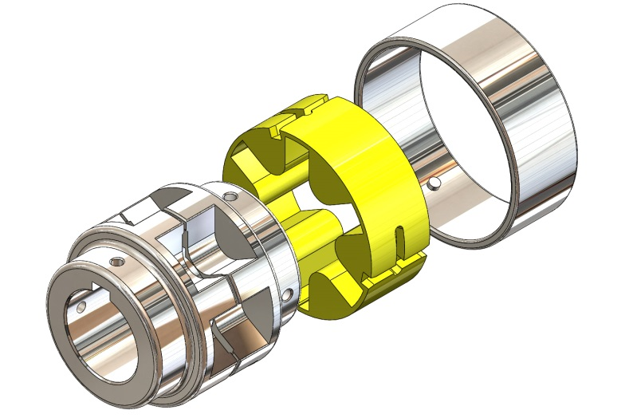


WHY ATRA-FLEX?
Quick, low cost solution for rotating Equipment, Misalignment, end Float and Vibration Troubles
Learn why Atra-Flex couplings are one of the easiest couplings to install and one of the lowest maintenance couplings on the market.
Detailed instructions A and M series
Company Video
www.atra-flex.com

Slide 2

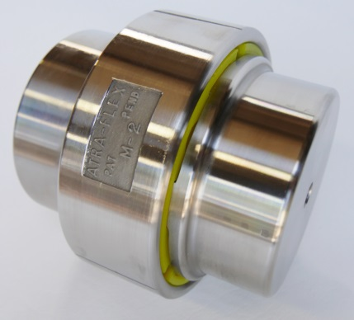
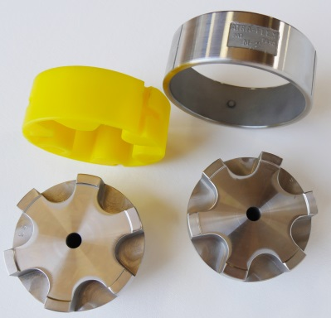
Provides Solutions
There is a solution to one of the most persistent and troublesome problems facing maintenance personnel-
Periodic Coupling failures and the downtime and expense that go with it. If a new insert is needed, a low cost replacement can be installed in minutes without moving either the prime mover or the driven equipment.

Slide 3
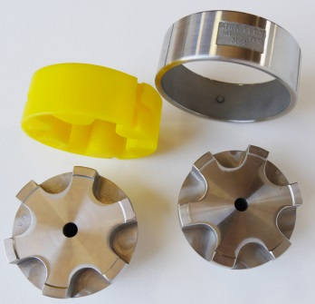

Save Money and Downtime
Only 4 parts to the coupling that make ATRA-FLEX, original A Series® and Millennium Series® an excellent choice when reliability and cost savings are your focus.
No lubrication needed
No nuts or bolts
No metal to metal contact so no need to replace steel hubs making ATRA-FLEX® one of the fastest installations and maintenance couplings on the market.
Replace grid, gear and disc pack style couplings
Handles torque ratings up to 3,610,00 (in-lb), More than most elastomeric couplings making it an excellent coupling for standardization.
The only inventory stocked is your polyurethane inserts.

Slide 4

Industrial Industry Today
What are the most troublesome issues Plants and Mills are facing today?
1. Unscheduled Downtime, Lost Production/Revenue
2. Costly Maintenance Programs/Reliability
3. Back Orders and Unacceptable Delivery Times
4. Increasing EPA Regulations on Lubricants

Slide 5
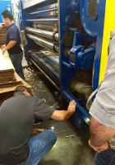
Unscheduled Downtime
What are the biggest challenges of unscheduled downtime ?
Production Loss / Loss of Revenue
Only Focused on Emergency
Labor Costs
Planning for Lockout
Backorders and Delayed Delivery
Often Times Temporary Band-aid, No Solution

Slide 6
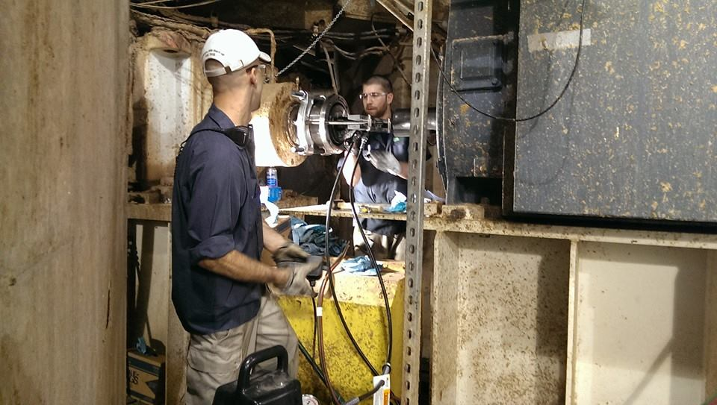
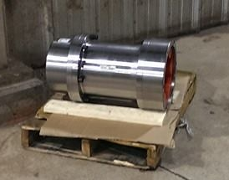
Labor cost that come with lengthy and troublesome Installations and repairs
Coupling Maintenance Challenges
ATRA-FLEX Flexible couplings have replaced many Grid and Gear couplings

Slide 7
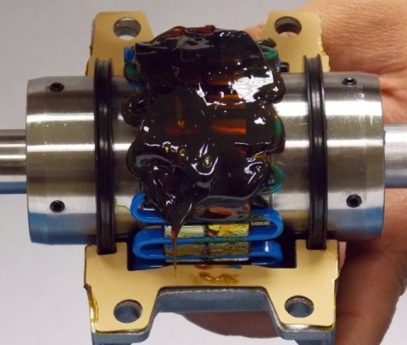
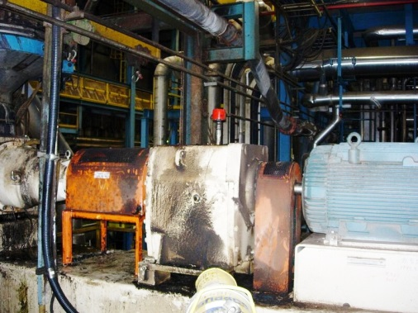
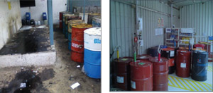
Challenges Associated with Grid and Gear Coupling Maintenance Programs
Couplings Will Need to Be Inspected & Re-Greased Periodically - As a best practice, metallic gear and grid couplings should be inspected regularly and repacked with grease each time. For a new coupling or application, you will want to inspect more regularly to ensure the coupling is behaving properly (i.e. - not leaking much grease). Overtime, application-specific, inspections can be spread out a bit more.
Be Prepared for Possible Leakage of Grease - While gear and grid couplings are renowned for their power density (can carry high torques in a small footprint) and ability to handle axial float (in the case of grid and floating shaft gear couplings), no matter the manufacturer, greased couplings are naturally prone to possible grease leakage. Appropriate care must be taken to minimize environmental concerns, and ensure all relevant environmental regulations that may apply are adhered to.
Storage Rooms / Inventory Space : Customers are continually seeking ways to standardize and lower inventory footprint. ATRA-FLEX couplings have no metal to metal contact after inserts shear, eliminating the need to stock additional hubs.

Slide 8
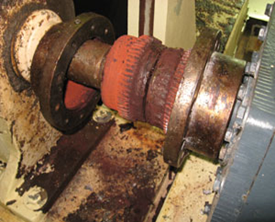
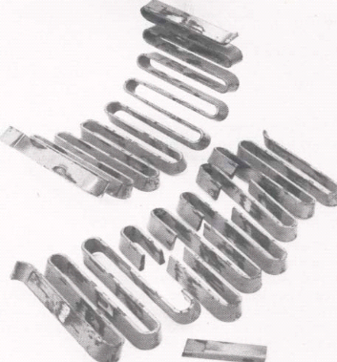
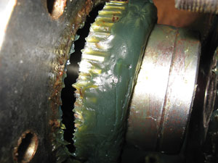
Costs Associated with Grid and Gear Coupling Failures
Lack of Procedures =Failures =Downtime=Loss of Revenue
Procedures and lack of timely execution
Lubrication programs are only as good as the people who do the work
As knowledgably baby boomers retire the steep learning curve in younger generations has been a growing concern for some plants, the lube-tech position may have been held by a single person for decades.
Back orders on replacement coupling parts
Long wait time on imports

Slide 9


Expense of Purchasing and Disposing of Messy Lubricants
Disposal costs. According to Valin (http://www.valin.com/index.php/ blog/15-filtration/117-cut-lubricantcosts- up-to-50), proper disposal of lubricants by a process management company can amount to approximately 20 percent of the cost of annual lubricant expenditures. This means if a plant spends $50,000 per year on lubricants, they will spend approximately $10,000 in disposal costs. In addition, the cost of the lubrication itself can impact overall expenditures, as it is normally petroleum-based and directly linked to the price of oil.

Slide 10
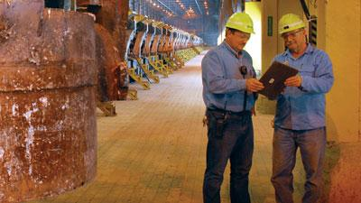
Save money and downtime with ATRA-FLEX®
Reliability is of top importance in most operations today. Save money and downtime by using ATRA-FLEX Flexible Couplings while increasing reliability and production. The ease of installation and the ability to change out your polyurethane insert within minutes will often take less time than a lock out/ Tag out procedure.

Slide 11


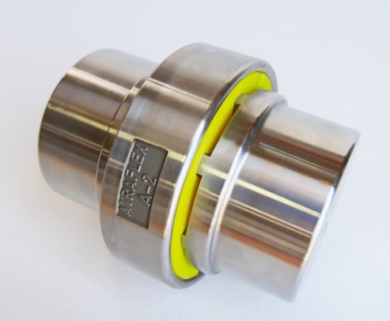
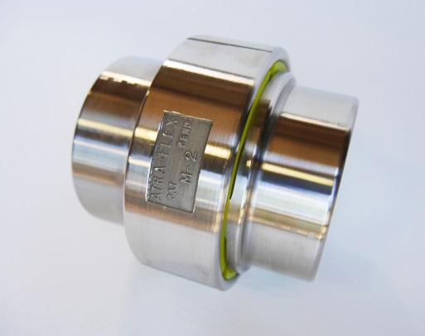

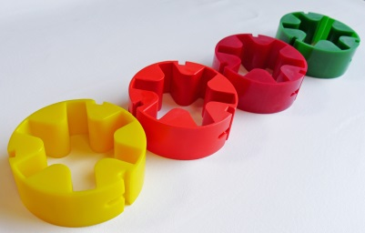

A Series and Millennium® Series Installation Instructions
Auto Sizing Program
A series & Millennium Series Installation instructions
A Series
Millennial “M” Series
For inquiries or technical support please visit www.atra-flex.com or call 1-800-443-6613

Slide 12
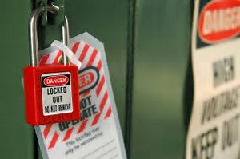

Safety and Preparation
Lock out/Tag out
Make sure all lock out and shut down procedures have taken place.
Safety Equipment
Make sure the installer is wearing all necessary protective gear. Gloves and protective eyewear.
Inspection
Make sure both shafts and hubs are free from any debris.
Tools Required
Standard Mechanics tools, straight edge and feeler gauge, dial indicator or laser alignment tool

Slide 13
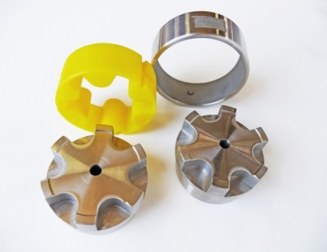
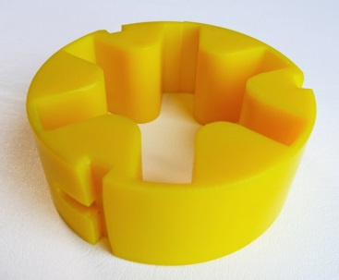
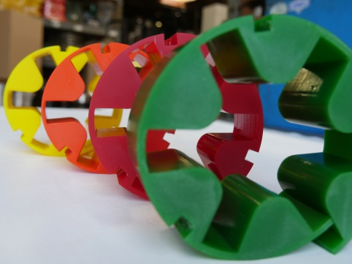
Coupling Parts
There are only 4 parts to an ATRA-FLEX A Series and Millennium “M” series Coupling. For this demo we will be using the M series coupling with our standard yellow insert.
Parts consist of 2 hubs, one ring and one standard Polyurethane Yellow Insert or insert required for your specific application.
** Refer to ATRA-FLEX catalog for insert selection guide.

Slide 14
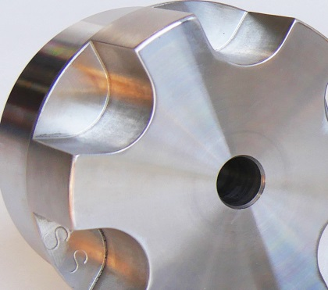
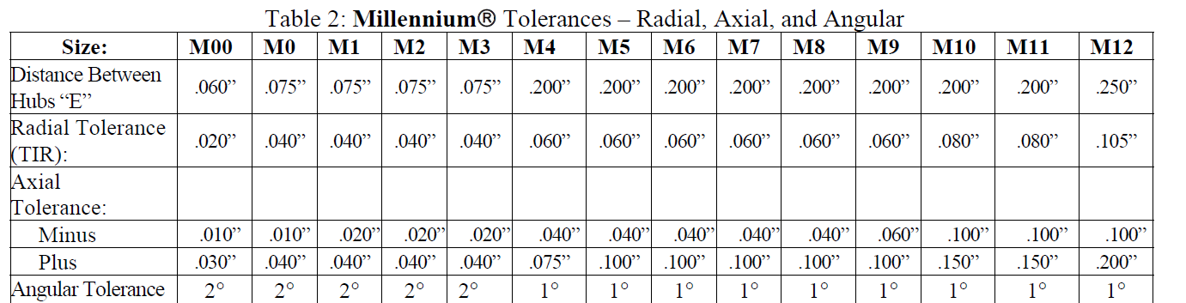
Install Hubs on shafts
After you have inspected hubs and shafts from debris slide ring over one shaft and then install both hubs onto shafts.
Make sure to properly align your equipment
With a straight edge applied across the teeth of both hubs, the straight edge must rest squarely or within the radial tolerances on table. This process should be done at 90 degree intervals. The use of a dial indicator or laser alignment tool will allow for closer tolerances in alignment.

Slide 15
Check Alignment of shafts and set proper “E” Gap
Please Note: Detailed attention to alignment tolerances and “E”Gap Dimension will give you the best efficient transfer of torque and insert wear.
For A Tolerance chart

Slide 16



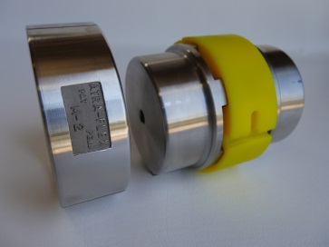
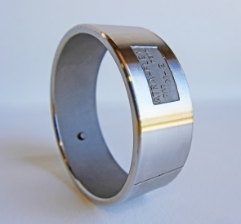
Tighten the set screws, Install the insert and Ring
●Tighten the set screws
After hubs and holding ring are installed on shafts, the teeth are then aligned parallel to each other, but not touching. (Please refer to proper E Gap tolerances on included instructions) Double check alignment. If alignment is within listed tolerances proceed to next step. If the tolerances are not correct then realign hubs. Once installed the hubs never need to be moved again.
●Insert the Polyurethane Insert
The elastic insert can then be installed in the slots formed by the parallel teeth. The insert should fit loosely(approximately .010 to .070 per side depending on the size. The T- Slot should be inserted so that the T-Slot is opposite of the rotation of the coupling.
●Install the Ring
When the insert is in position, slide the holding ring onto the polyurethane insert. Align the pins with the rings in the slots on the insert and slide the ring over the insert. The ring is in place when the pins are in the locator on the insert. On larger rings a soft mallet might be needed to move the ring over the insert and in place.

Slide 17

ATRA-FLEX® A Series and Millennium Series accommodates horizontal, vertical, stop start applications and can rotate in either direction.
All complete couplings or replacement inserts come with a standard T-Slot unless otherwise requested.
This is an Image of ATRA-Flex VHS Inserts for Vertical Applications
Align the pins with the rings in the slots on the insert and slide the ring over the insert. The ring is in place when the pins are in the locator on the insert. On larger rings a soft mallet might be needed to move the ring over the insert and in place.

Slide 18



Change out on a ATRA-FLEX coupling is faster than any other.
To Disassemble, ensure all rotating equipment is shut down and all necessary lock out/tag out has been established.
Remove the ring and slide over the shaft. The insert can quickly and easily be replaced. No special tools, screws, bolts or other fasteners needed.

Slide 19


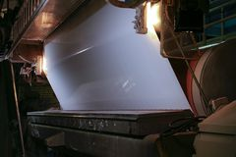





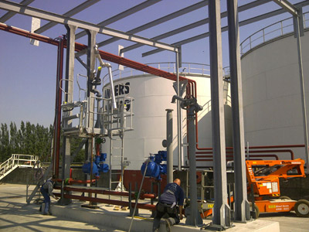
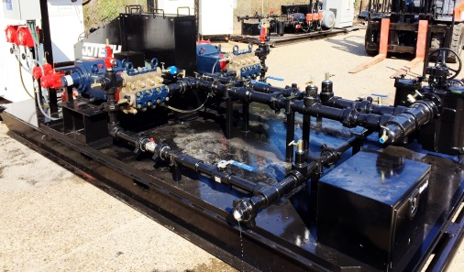
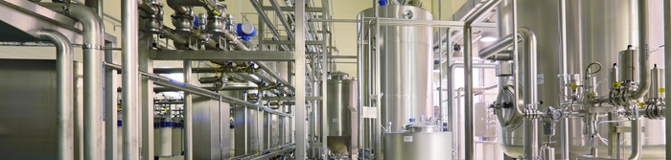
Visit us at www.atra-flex.com to locate your local distributor or Sales Rep 800-443-6613
Industries have relied on ATRA-FLEX Flexible Couplings to keep them in motion while saving on overall cost of ownership for over 36 years. The quality and customer service has set ATRA-FLEX apart in the industry and our commitment to long term customer satisfaction is unmatched.

